Slide 1


REACT JS

Slide 2
Introduction
React is a JavaScript library for building user interfaces.
It’s ‘v’ in MVC. React JS is an open-source, component-based front end library responsible only for the view layer of the application.
React is created by Facebook.
React is used to build single page applications.

Slide 3
Single Page Application
A single-page application (SPA) is a web application or website that interacts with the web browser by dynamically rewriting the current web page with new data from the web server.
Instead of the default method of the browser loading entire new pages.
The goal is faster transactions that make the website feel more like a native app.

Slide 4
Native App
A native app is one that is installed directly on the smartphone and can work, in most cases, with no internet connectivity depending on the nature of the app.
A web app works via a web browser on the smartphone but requires either a cell signal or wi-fi to function.

Slide 5
ReactJS Virtual DOM
React creates a VIRTUAL DOM in memory.
Manipulating Real DOM is much slower than manipulating virtual DOM because nothing gets drawn on the screen.
When the state of an object changes, Virtual DOM changes only that object in the real DOM instead of updating all the objects. Virtual DOM makes React extremely powerful and efficient.
React only changes what needs to be changed!

Slide 6
Install NodeJS and npm
Recommended NodeJS and npm for using ReactJS in your system / PC.
npm – node package manager
Open-source developers use npm to share software.
npm is the world’s largest software library
8 Lakhs code packages.
npm is installed with Node.js
This means that you have to install Node.js to get npm installed on your computer.

Slide 7
How to Create React App
You must have Nodejs 8.10 above version and npm 5.6 above version in your system.
After install it for creating a react app you command the below line in your command prompt.
Npx create-react-app my-app
Cd my-app Npm start
Editing your react code in visual studio code command the below line in your command prompt.
Cd My-app code

Slide 8
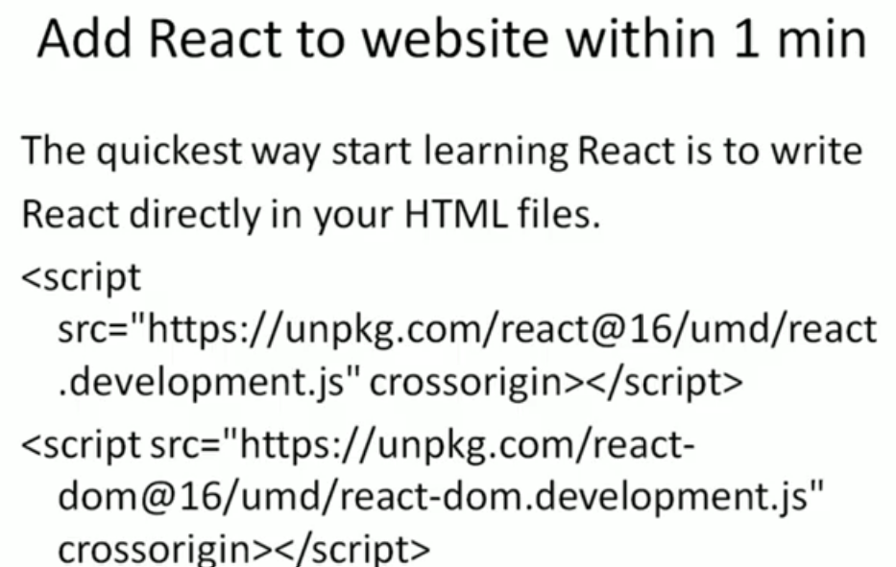

Slide 9

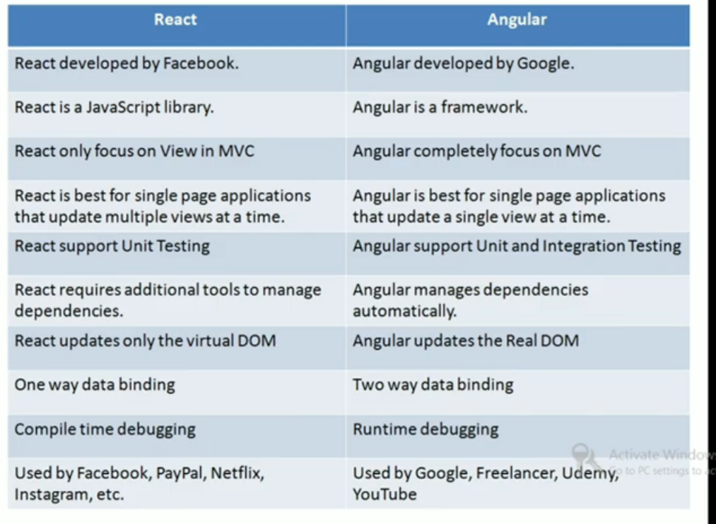

Slide 10
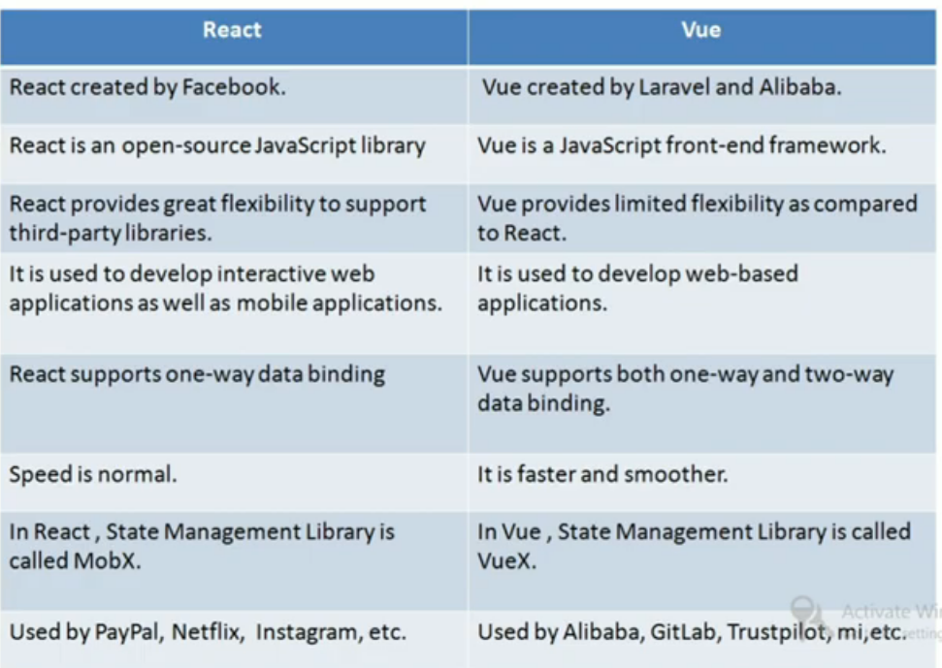

Slide 11
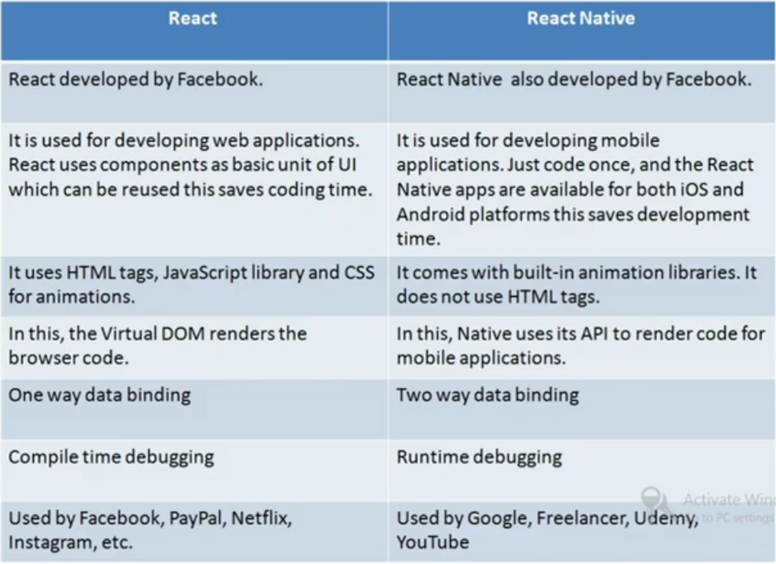

Slide 12
REACT ES6
ES6 stands for ECMA Script 6 version
ECMA Script is the standardization of Javascript programming language.
Use of ES6 features we Write Less and Do More.
Some of the new features like:
Classes
Arrow functions
Variables (let, const, var)

Slide 13
Features of ES6
Class – A class is used to bind data as well as methods together as a single unit. Object acts like a variable of the class.
ARROW – To write a shorter syntax for the function we use ARROW.
VAR – If we use outside the function its called global variable. If we use inside the function its called local variable.
CONST-Once we assign a variable as constant we never change it.
LET-If you use var inside a for loop or any other block, the variable also available outside of that block or loop, so we use “LET” for overcoming from this problem.
If we use variable as let in block or loop, then the value only available inside the block only.

Slide 14
React JSX
JSX stands for JavaScript XML.
JSX allows us to write HTML in React.
JSX allows us to write HTML elements in JavaScript and place them in the DOM without any createElement()

Slide 15
React Components
Every application you will develop in React will be made up of pieces called components.
Components make the task of building UIs much easier.
We have lot of individual components like a single web page contain (search bar, menu bar, nav bar, content, article etc;)
Merge all of these individual components to make a parent component which will be the final UI.
Two types of components
Functional Component
Class component

Slide 16
React Props
Props stand for “properties.”
React allows us to pass information to a Component using props.
Props are immutable so, we cannot modify the props from inside the component.
Props are basically kind of global variable or object. It is an object which stores the value of attributes of a tag and work similar to the HTML attributes.
We can access any prop from inside a component’s class using the below syntax
this.props.propName;

Slide 17
React State
React components has a built-in state object.
To define a state, you have to first declare a default set of values for defining the component’s initial state.
To do this, add a class constructor which assigns an initial state using this.state
The ‘this.state’ property can be rendered inside render() method.
this.props.propertyName;
When a value in the state object changes, the component will re-render, so, the output will change according to the user values(s).
this.setState()

Slide 18
Props VS State
props | state
Props are immutable | State is mutable
Props allow you to pass data from one component to other components as an argument. | State holds information about the components.
Props can be accessed by the child component. | State cannot be accessed by child components.
Props are used to communicate between components. | States can be used for rending dynamic changes with the component.

Slide 19
React lifecycle
In React every components has various lifecycle methods.
All the lifecycle methods are comes under the four phases.
Initial phase
Mounting phase
Updating phase
Unmounting phase

Slide 20
Initial phase
In this phase the developer has to define the props and initial state of the component this is generally done in the constructor of the component
getDefaultprops()
It is used to specify the default value of this.state. It is invoked before the creation of the component.
getInitialState()
it is used to specify the default value of this.state. It is invoked before the creation of the component.

Slide 21
Mounting phase
After the initialization of the component is completed, then the component is mounted on the DOM and rendered for the first time in the webpage.
componentWillMount() Function: this function is invoked before the component is mounted on the DOM.
This function gets invoked once before the render() function is executed for the first time.
In the case, when you call setState() inside this method, the component will not re-render.
componentDidMount() Function: this function is invoked after the component is mounted on the DOM.
This funcyion gets invoked once after the render() function is executed for the first time.
Now, you can do any DOM querying operations.

Slide 22
Updating phase
Updation is the phase where the states and props of a component are updated followed by some user events such as clicking or pressing button.
componentWillUpdate() Function:
This function is invoked once before the component is rerendered.
This function gets invoked once before the render() function is executed after the updation of State or props.
componentDidUpdate() Function:
Similarly this function is invoked once after the render() function is executed after the updation of State or props.

Slide 23
Unmounting phase
componentWillUnmount()
This method is invoked immediately before a component is destroyed and unmounted permanently.
It performs any necessary cleanup related task such as invalidating timers, event listener, canceling network requests, or cleaning up DOM elements.
If a component instance is unmounted. You cannot mount it again.

Slide 24
React “This” keyword
Regular function:
The “this” represents the object that called the function.
It means there is an different objects depending on how the function was called, which could be the window, the document, a button or whatever.
Arrow function:
The “this” keyword always represent the object that defined the arrow function.
No matter who called the function.

Slide 25
React Event Handling
An event is an action that could be triggered as a result of the action or system generated event.
For example, a mouse click, loading of a web page, pressing a key, window resizes, and other interactions are called events.
React events are named using camelCase, rather than lowercase.
In react. With help of JSX you pass a function as the event handler, rather than a string.
Onclick={shoot} instead of onclick=“shoot()”

Slide 26
React CSS
CSS-Cascading Style Sheets
In React we use CSS to style the React App or Component.
Here we are going to discuss mainly three ways to style React Components.
Inline Styling
Css Stylesheet Css Module

Slide 27
Possible Way Of Adding CSS To React Components
Inline styling:
To style an element with the inline style attribute, the value must be a JavaScript object {{}}.
If the properties have two names, like background-color, it must be written in camel case syntax.
CSS Stylesheets:
you can write your CSS styling in a separate file, just save the file with the CSS file extension, and import it in your application.
CSS Modules:
CSS Modules are convenient for components that are placed in separate files.
The CSS inside a module is available only for the component that imported it.
It means any styling you add can never be applied to other components without your permission, and you do not have to worry about name conflicts.
You can create CSS Module with the .module.css extension like a mystylessheet.module.css name.

Slide 28
React Sass
Sass-Syntactically Awesome Stylesheet
Sass reduces repetition of CSS and therefore saves time.
Sass have lot of features that do not exist in CSS, like variables, nested rules, imports, inheritance, built-in functions etc;
Install Sass in your React App by running this command in your terminal
npm install node-sass
Sass uses the $ symbol, followed by a name, to declare variables
$variablename: value;
A browser does not understand Sass code. Therefore, you will need a Sass pre-processor to convert Sass code into standard CSS. This process is called transpiling.
Transform/translate it into another language.

Slide 29
React Forms
Forms play a major role in any website for login, sighnup etc;
In React Forms work little different.
In HTML, form data is usually handled by the DOM.
In HTML elements like input tag, the value of the input field is changed whenever the user type.
In react, form data is usually handled by the components.
But, in React, whatever the value user types we save it in state and pass the same value to the input tag as its value, so here its value is not changed by DOM, it is controlled by react state

Slide 30
React Fragments
In React, whenever you want to render something om the screen, you need to use to use a render method inside the component.
The render method will only render a single root node inside it at a time.
However, if you want to return multiple elements, the render method will require a ‘div’ tag and put the entire content or elements inside it.
This extra node to the DOM sometimes results in the wrong formatting of your HTML output and its not good semantic html code.
Advantage of using react fragmentsis it take lesser memory and quicker execution.

Slide 31


React Lists
Lists are used to display data in an ordered format and mainly used to display menus on websites like navigation bar, menu bar etc;
Let us now create a list of elements in React.
To do this, we will traverse the list using the javasvript map() function and updates elements to be enclosed between <Ii> </Ii> elements.
Finally we will wrap this new list within <uI> </uI> elements and render it to the DOM.

Slide 32


React Keys
A “key” is a special string attribute you need to include when creating lists of elements in React.
Keys are used in react to identify which items in the list are changed, updated or deleted. In other words we can say that keys are used to give an identify to the elements in the lists.
It also helps to determine which components in a collection needs to be re-rendered instead of re-rendering the entire set of components every time.

Slide 33


React Hooks
React Hooks allows you to use state and other React features without writing a class.
It does not work inside classes. Its work inside the function only.
Rules of Hooks:
Only call Hooks at the top level
Do not call Hooks inside loops, conditions, or nested functions.
Hooks should always be used at the top level of the React functions.
Only call Hooks from React functions
You cannot call Hooks from regular JavaScript functions.
Instead, you can call Hooks from React function components.
Hooks can also be called from custom Hooks.

Slide 34


React Router
React Router is mainly used for developing a Single Page Web Applications. It plays an important role to display multiple views in a single page application.
Routing is a process in which a user is directed to different pages based on their action or request.
When a user types a specific URL into the browser, and if the URL path matches any ‘route’ inside the router file, the user will be redirected to that particular route.
Most of the social media websites like Facebook, Instagram uses React Router for rendering multiple views.

Slide 35

Import{ Brower router as router,route,link,navlink,switch}
Route-is the conditionally shown component based on matching a path to a URL
Browser Router-is the router implementation it uses HTML 5 history API (i,.E.pushstate,replacestate and popstate API) to keep your UI in sync with the URL.
Memory router- memory router keeps the URL changes in memory not in the user browers.it does not read or write to the address bar so the user can not use the browser’s back button as well as the forward button.it is very useful for testing and non-browser environments like react native.
Link- is your replacement for anchor tags.sometimes,we want to need multiple links on a single page.this <link>component is used to create links which allow to navigate on different URLS and render its content without reloading the webpage.
Navlink-component is used to add styles to the active routes and add properties activestyle. The activestyle properties mean when when we click on the link, it should have a specific style so that we can differentiate which one is currently active.
Switch-the <switch>component is used to render component only when the path will be matched. Otherwise, it returns to the not found component.

